Slide 1

By ALM Team

Slide 2
Agenda
Why Confluence?
Team collaboration
Agile development
Knowledge base

Slide 3






Why Confluence? | Team Collaboration | Agile Development | Knowledge Base
Centralize
Organize
Create
Discuss
Search
Get answers
JIRA Integration
Capturing the knowledge is too often lost in email inboxes and shared network drives

Slide 4

Why Confluence? | Team Collaboration | Agile Development | Knowledge Base
Centralize
Organize
Create
Discuss
Search
Get answers
JIRA Integration
Capturing the knowledge is too often lost in email inboxes and shared network drives
Use Confluence instead – where it's easy to find, use, and update.

Slide 5
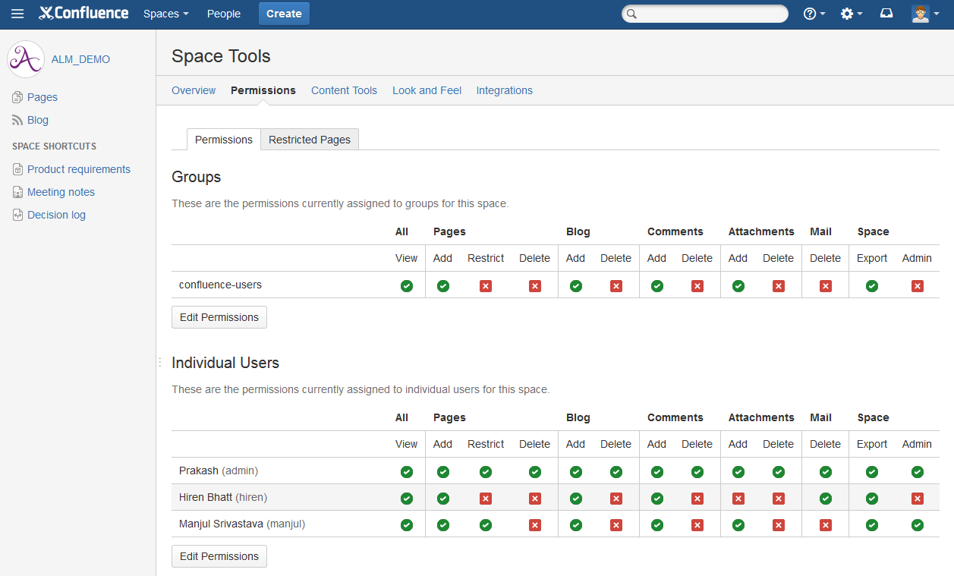
Why Confluence? | Team Collaboration | Agile Development | Knowledge Base
Centralize
Organize
Create
Discuss
Search
Get answers
JIRA Integration
Organize Team: Give every team, project or department its own space with its own permissions and theme.

Slide 6
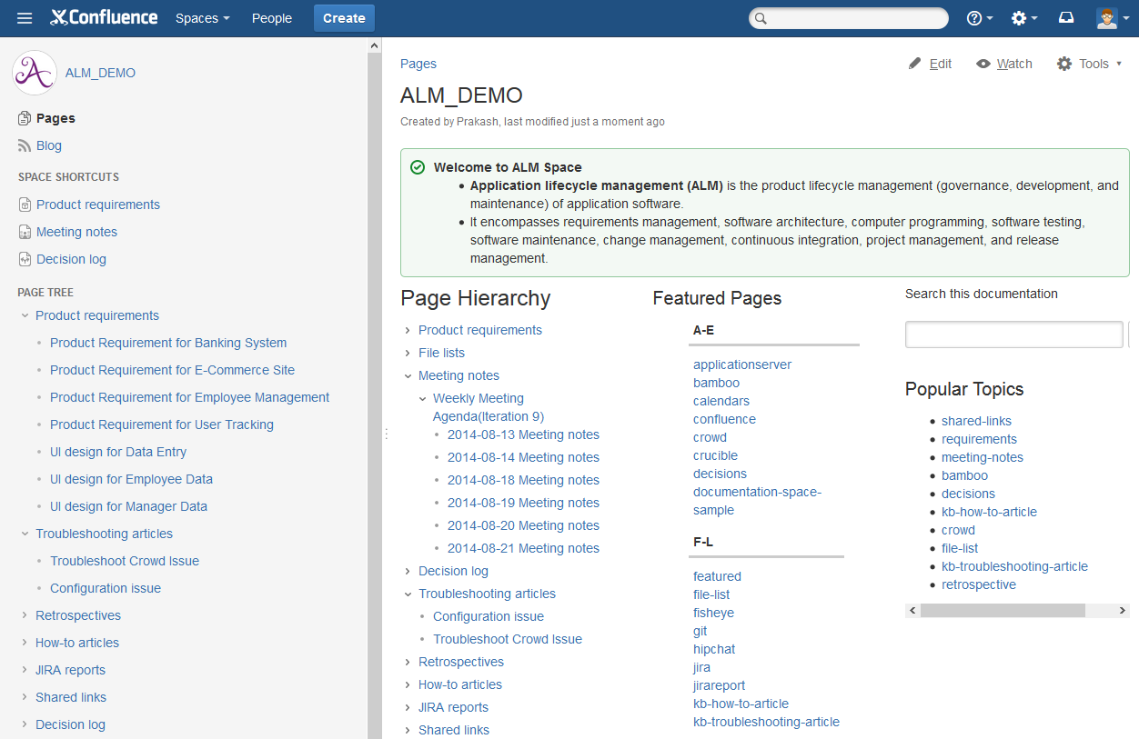
Why Confluence? | Team Collaboration | Agile Development | Knowledge Base
Centralize
Organize
Create
Discuss
Search
Get answers
JIRA Integration
Organize Information: Keep information organized and accessible with a flexible page hierarchy.

Slide 7
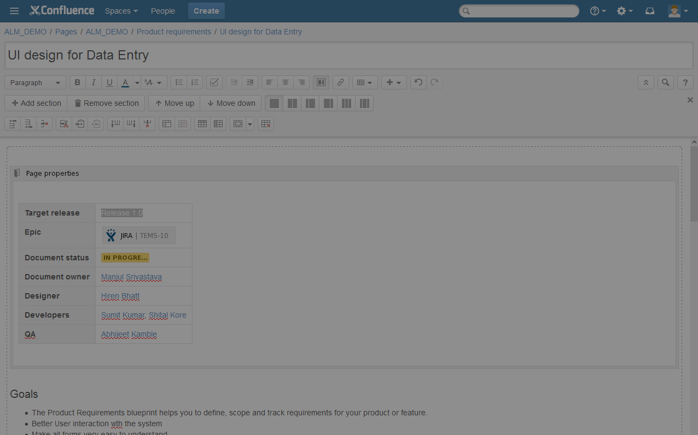
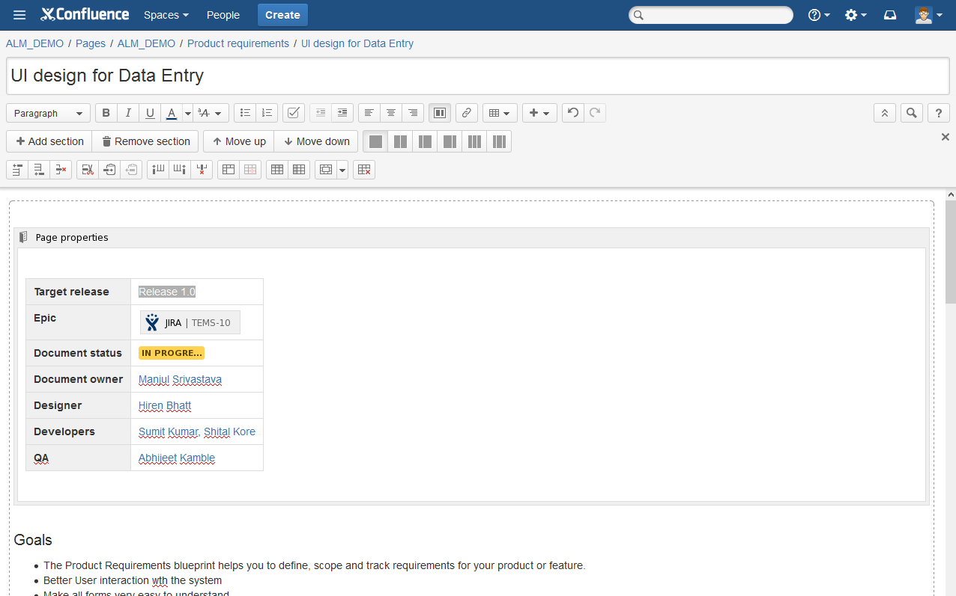
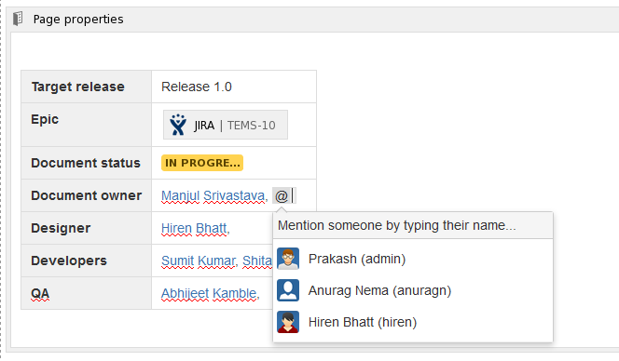
Why Confluence? | Team Collaboration | Agile Development | Knowledge Base
Centralize
Organize
Create
Discuss
Search
Get answers
JIRA Integration
Create anything with a rich content editor in your web browser.

Slide 8
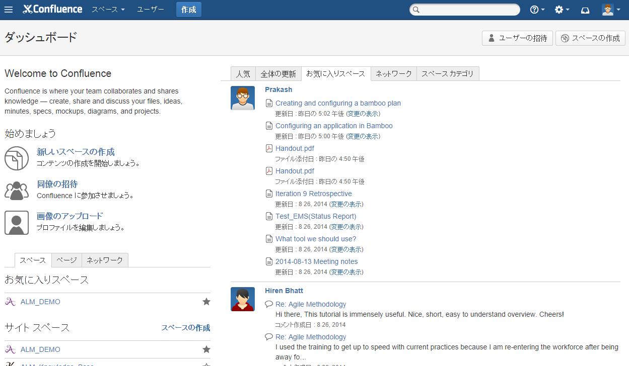
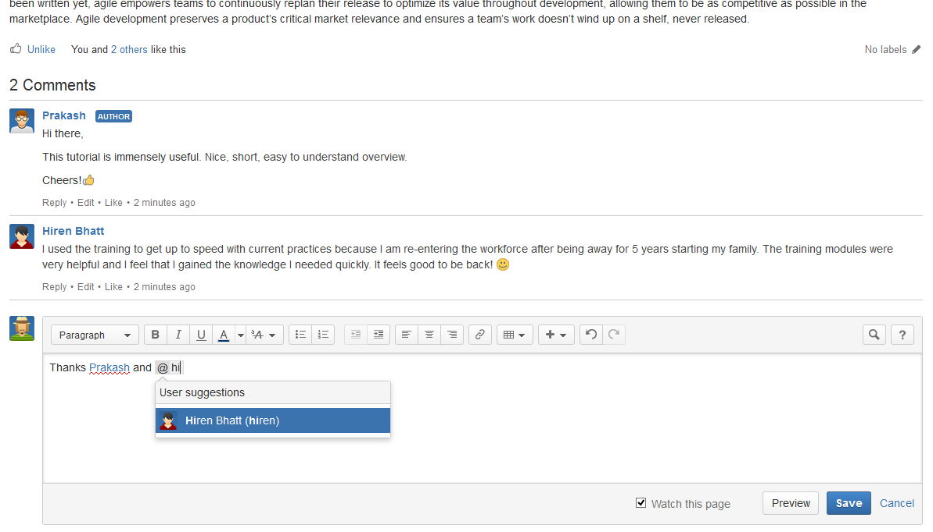
Why Confluence? | Team Collaboration | Agile Development | Knowledge Base
Centralize
Organize
Create
Discuss
Search
Get answers
JIRA Integration
Engage everyone: Whether you're in the same office or across the globe, it's easy to work together using Confluence.

Slide 9
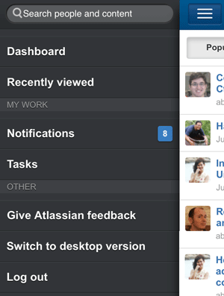
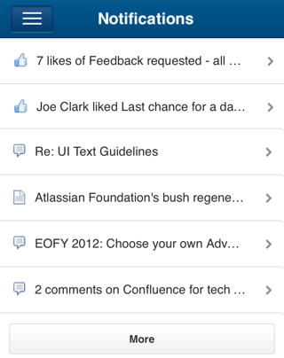
Why Confluence? | Team Collaboration | Agile Development | Knowledge Base
Centralize
Organize
Create
Discuss
Search
Get answers
JIRA Integration
Engage everyone: Whether you're in the same office or across the globe, it's easy to work together using Confluence.

Slide 10
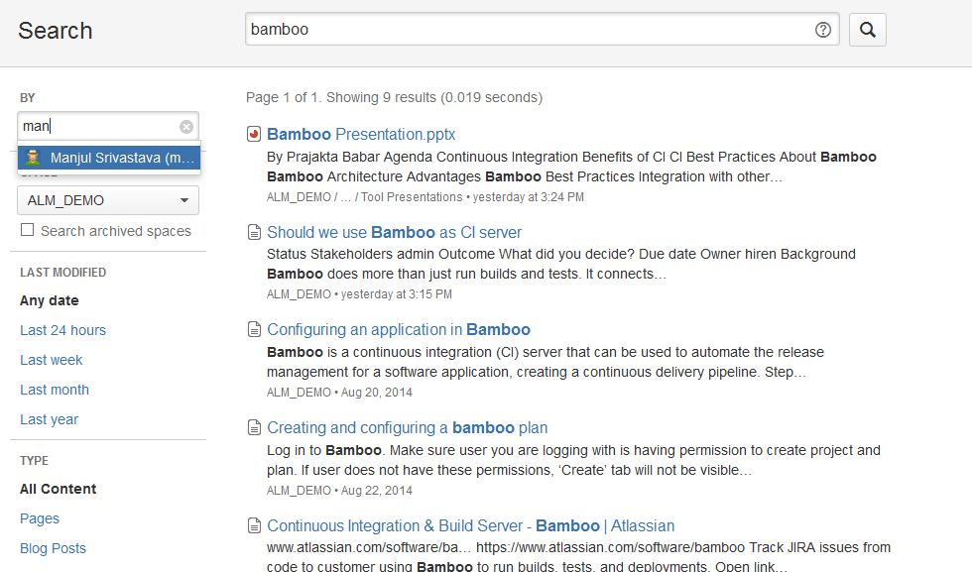
Why Confluence? | Team Collaboration | Agile Development | Knowledge Base
Centralize
Organize
Create
Discuss
Search
Get answers
JIRA Integration
Find what you need: When everything is in one place, you stop looking and start finding.

Slide 11
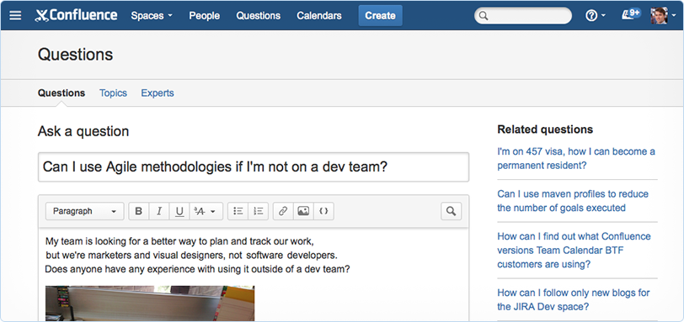
Why Confluence? | Team Collaboration | Agile Development | Knowledge Base
Centralize
Organize
Create
Discuss
Search
Get answers
JIRA Integration
Look, search, ask: Capture, learn from, and retain the collective knowledge of your organization as it grows.

Slide 12
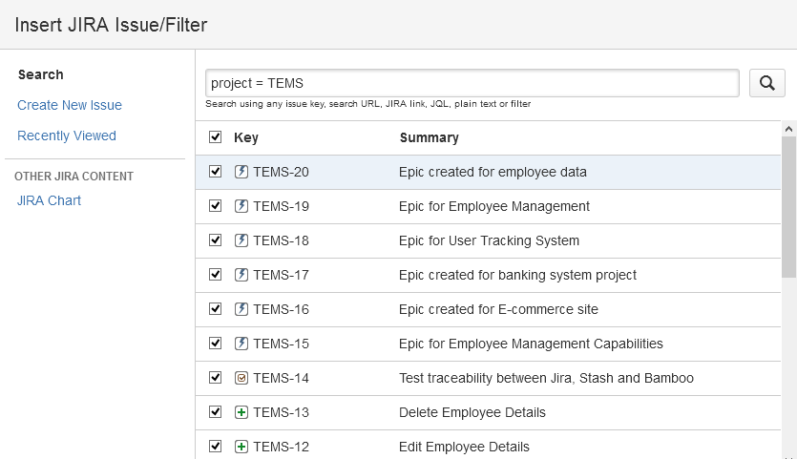
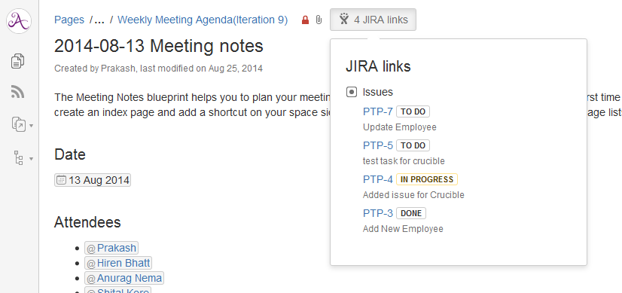
Why Confluence? | Team Collaboration | Agile Development | Knowledge Base
Centralize
Organize
Create
Discuss
Search
Get answers
JIRA Integration
Add clarity to JIRA: Transparency between the issues tracked in JIRA and related content in Confluence.

Slide 13
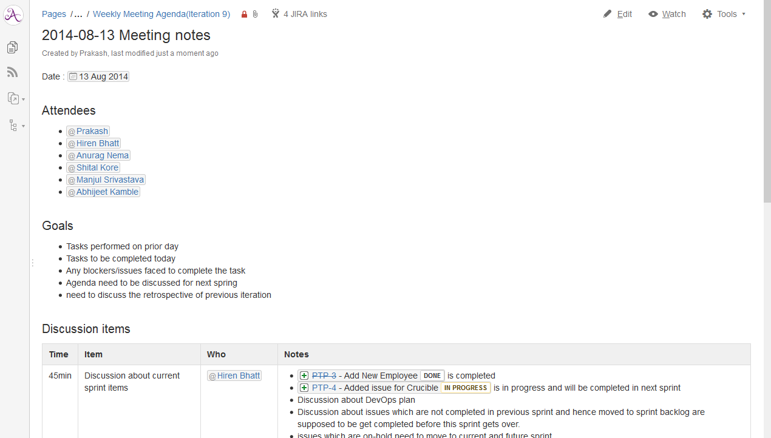
Why Confluence? | Team Collaboration | Agile Development | Knowledge Base
Meeting Notes
Share Files
Make Decisions
Share Links
Assign Tasks
Share Calendars
Make meetings count: With all your notes and action items in one place, you can give email a break.

Slide 14
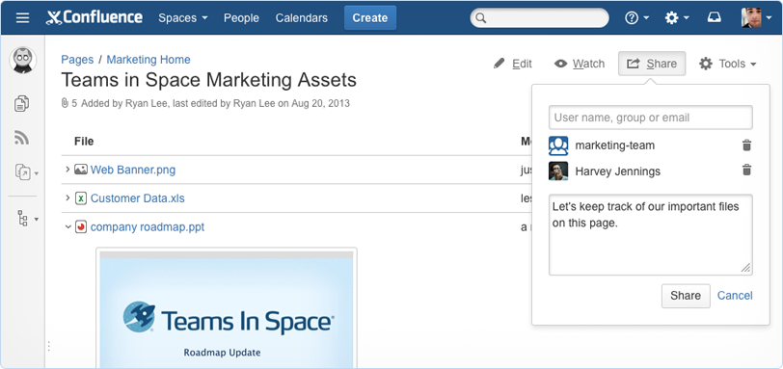
Why Confluence? | Team Collaboration | Agile Development | Knowledge Base
Meeting Notes
Share Files
Make Decisions
Share Links
Assign Tasks
Share Calendars
Engage everyone: Whether you're in the same office or across the globe, it's easy to work together using Confluence.

Slide 15
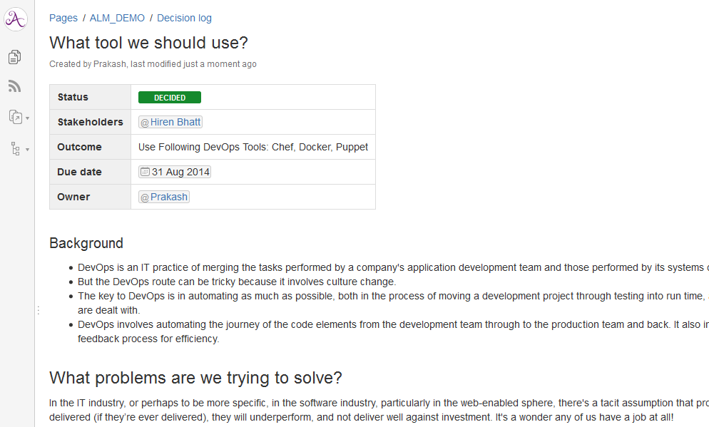
Why Confluence? | Team Collaboration | Agile Development | Knowledge Base
Meeting Notes
Share Files
Make Decisions
Share Links
Assign Tasks
Share Calendars
Decide faster, record forever: Save your team from endless loops of long meetings and frustrating email threads.

Slide 16
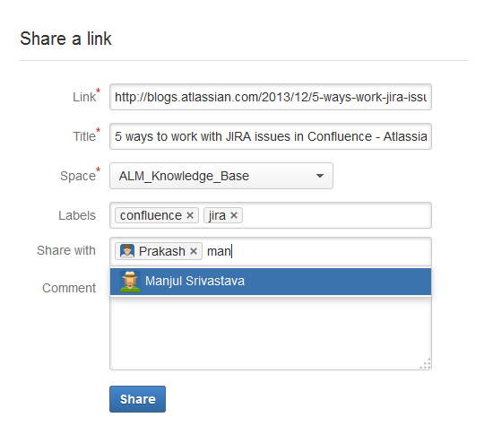
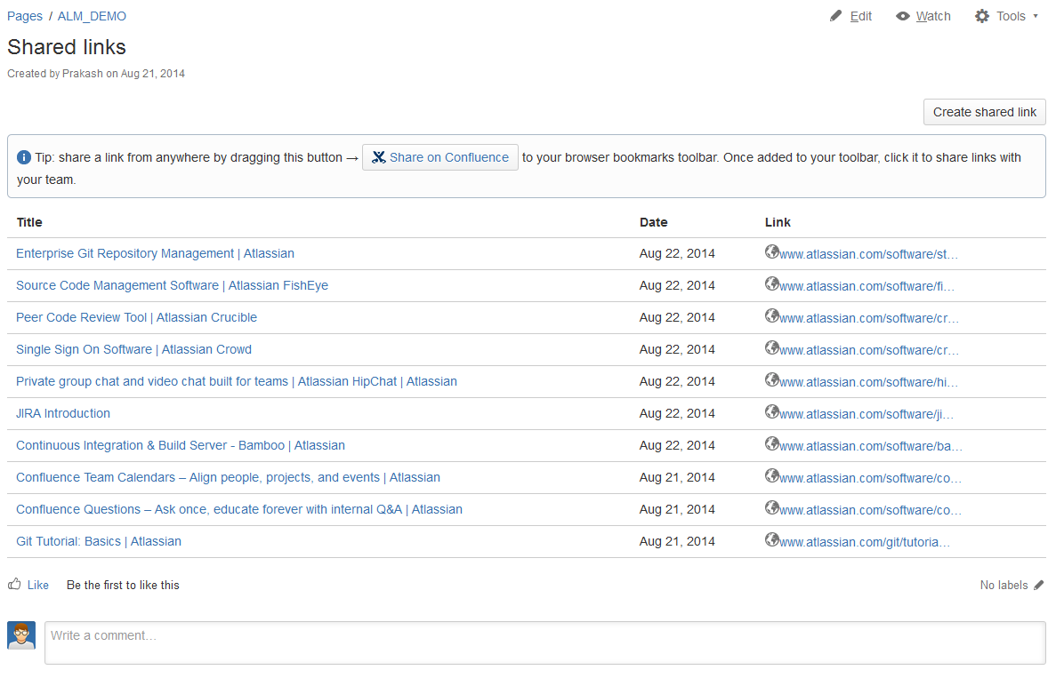
Why Confluence? | Team Collaboration | Agile Development | Knowledge Base
Meeting Notes
Share Files
Make Decisions
Share Links
Assign Tasks
Share Calendars
Share and build knowledge: Share anything you find on the web – articles, tweets, videos – and discuss it with your team.

Slide 17
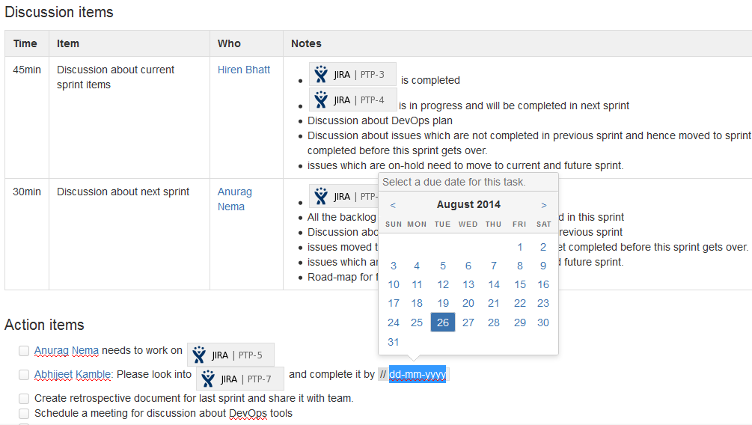
Why Confluence? | Team Collaboration | Agile Development | Knowledge Base
Meeting Notes
Share Files
Make Decisions
Share Links
Assign Tasks
Share Calendars
Stay on task: Assign tasks to teammates to keep work moving forward.

Slide 18
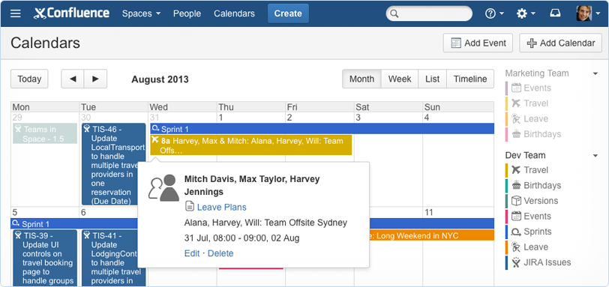
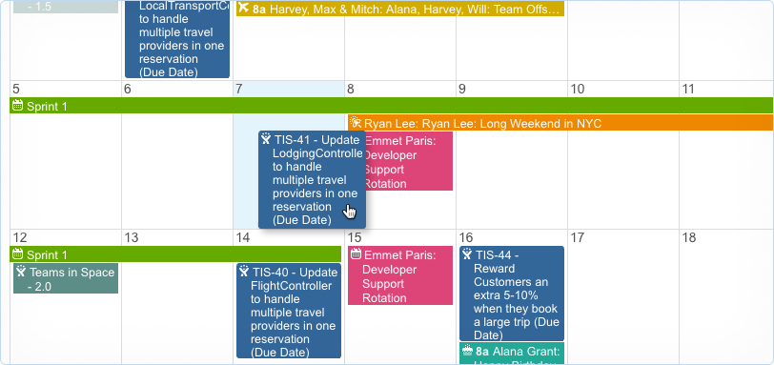
Why Confluence? | Team Collaboration | Agile Development | Knowledge Base
Meeting Notes
Share Files
Make Decisions
Share Links
Assign Tasks
Share Calendars
Schedule people, projects, and events: Manage team leave, track JIRA projects, and plan events with Confluence Team Calendars.

Slide 19
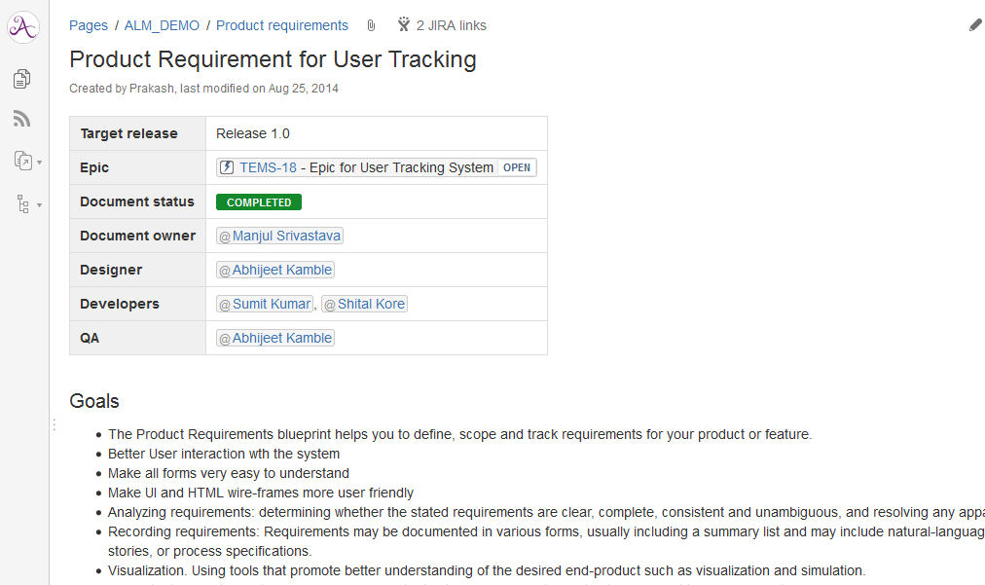
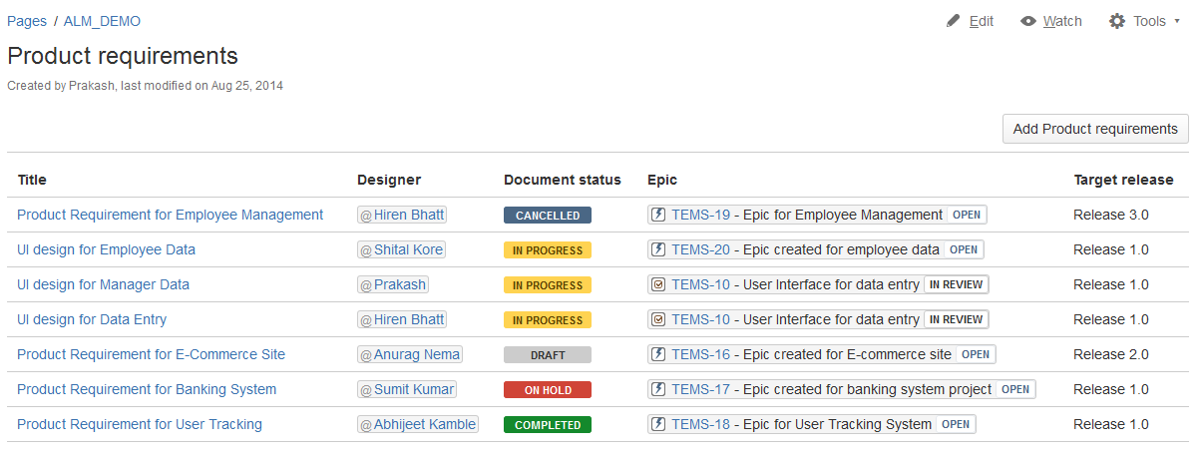
Why Confluence? | Team Collaboration | Agile Development | Knowledge Base
Requirement
Create JIRA Issues
Link to JIRA
Publish Reports
Track Releases
Retrospectives
Define product requirements: Document, discuss, and track product requirements so your developers can hit the ground running.

Slide 20
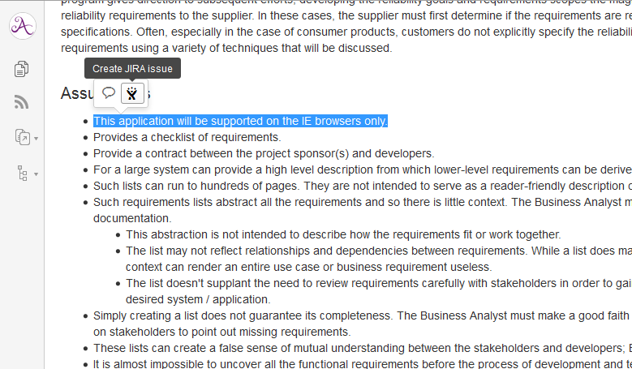
Why Confluence? | Team Collaboration | Agile Development | Knowledge Base
Requirements
Create JIRA Issues
Link to JIRA
Publish Reports
Track Releases
Retrospectives
Engage everyone: Whether you're in the same office or across the globe, it's easy to work together using Confluence.

Slide 21
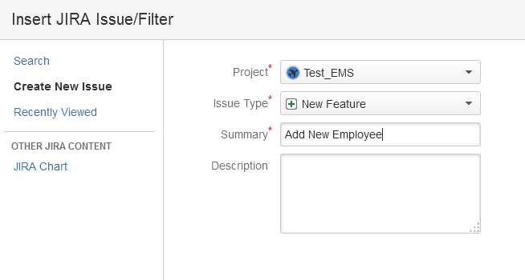
Why Confluence? | Team Collaboration | Agile Development | Knowledge Base
Requirements
Create JIRA Issues
Link to JIRA
Publish Reports
Track Releases
Retrospectives
Requirements → Backlog: Take your user stories in Confluence and put them in your backlog in JIRA without leaving Confluence.

Slide 22
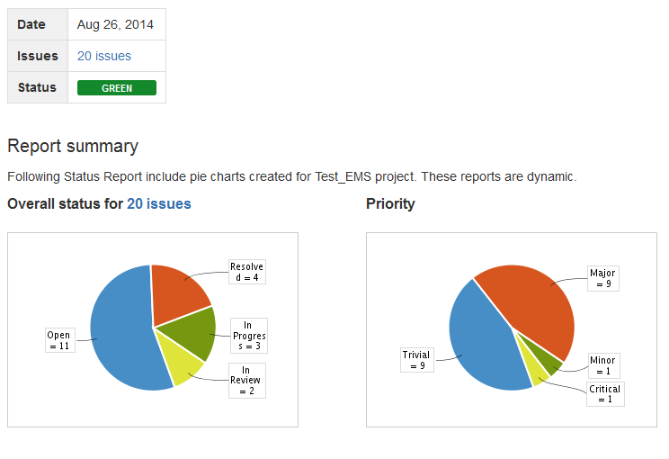
Why Confluence? | Team Collaboration | Agile Development | Knowledge Base
Requirements
Create JIRA Issues
Link to JIRA
Publish Reports
Track Releases
Retrospectives
Communicate progress: Keeping key stakeholders informed of the work your development team is doing in JIRA has never been this easy.

Slide 23
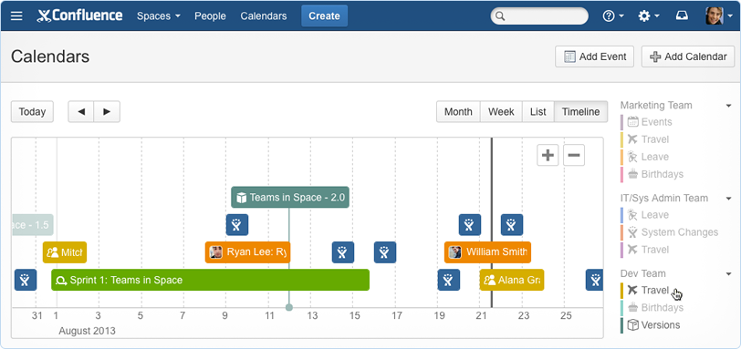
Why Confluence? | Team Collaboration | Agile Development | Knowledge Base
Requirements
Create JIRA Issues
Link to JIRA
Publish Reports
Track Releases
Retrospectives
Add Team Calendars: Surface everything your team is working on in JIRA to everyone else that lives in Confluence with Team Calendars.

Slide 24
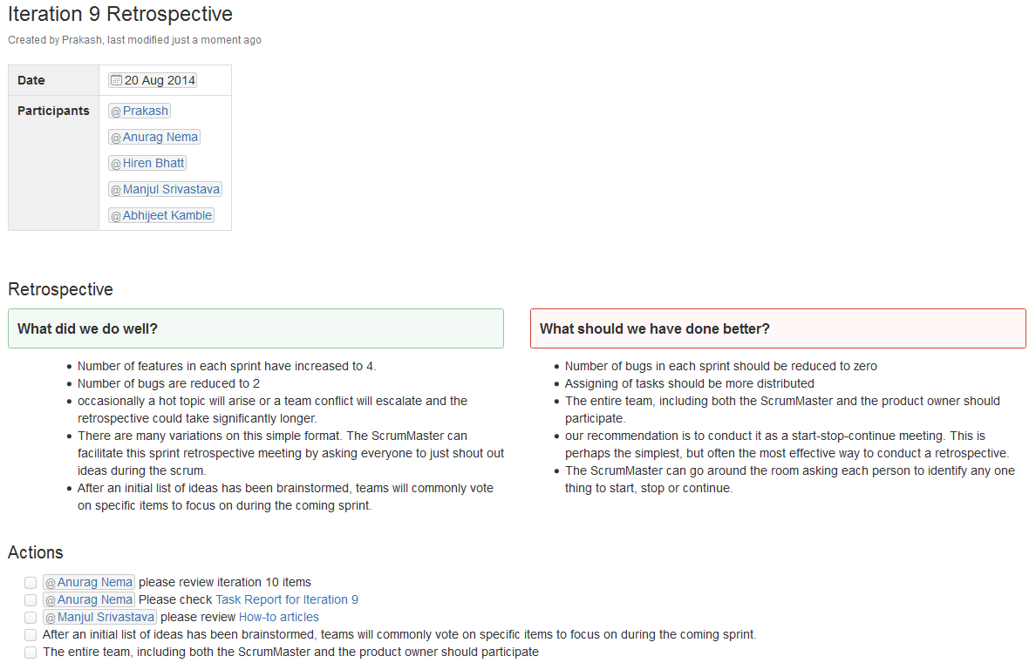
Why Confluence? | Team Collaboration | Agile Development | Knowledge Base
Requirements
Create JIRA Issues
Link to JIRA
Publish Reports
Track Releases
Retrospectives
Reflect and improve: Invite your team to reflect and improve – the agile way.

Slide 25
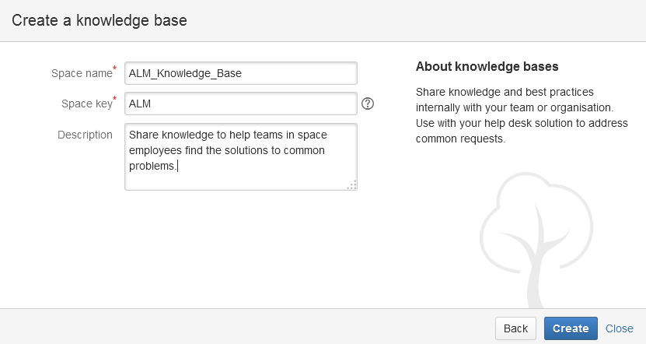
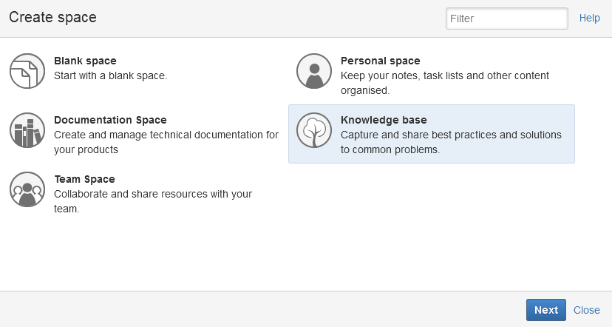
Why Confluence? | Team Collaboration | Agile Development | Knowledge Base
Simple Set up
Create Knowledge Articles
Instant structure
Connect to Service Desk
Set up in seconds: Set up your fully functional knowledge base space in a few clicks.

Slide 26
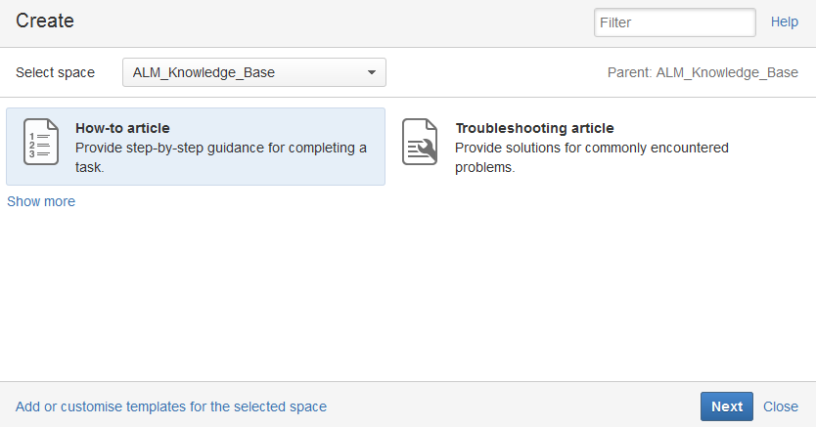
Why Confluence? | Team Collaboration | Agile Development | Knowledge Base
Simple Set up
Create Knowledge Articles
Instant structure
Connect to Service Desk
Bundled best practices: Quickly document solutions to known issues with the bundled how-to and troubleshooting article Blueprints.

Slide 27
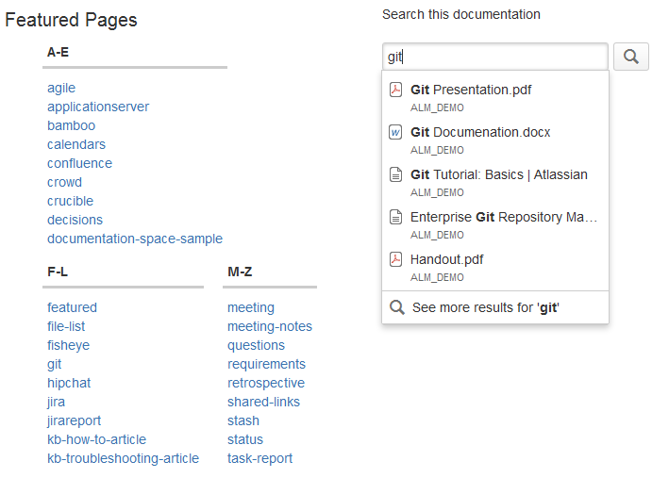
Why Confluence? | Team Collaboration | Agile Development | Knowledge Base
Simple Set up
Create Knowledge Articles
Instant structure
Connect to Service Desk
Structured and searchable: Help users find what they need by categorizing articles with labels.

Slide 28
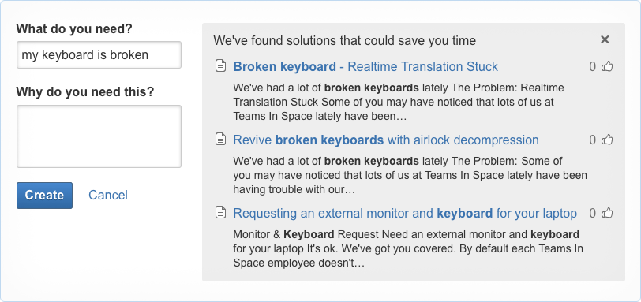
Why Confluence? | Team Collaboration | Agile Development | Knowledge Base
Simple Set up
Create Knowledge Articles
Instant structure
Connect to Service Desk
Connect to JIRA Service Desk: Confluence helps deflect requests by recommending relevant how-to and troubleshooting articles.

Slide 29
Best Practices
Creating space for
Set goals, define stakeholders, track progress of your project
It should be easy for team to work in this space.
Tracks all of the project’s important deliverables and milestones.
It should be easy for anyone else to learn what our team is up to.
Project
Team

Slide 30

Any Questions?

Slide 31
Glossary
Confluence : https://www.atlassian.com/software/confluence
Confluence Questions : https://www.atlassian.com/software/confluence/questions
Confluence Team Calendars : https://www.atlassian.com/software/confluence/team-calendars

Slide 32
Thank You!

